Slide 1


Total Compensation Survey
2019 Results

Slide 2
Total Compensation Survey
Goal
To understand POA employee perception of the current compensation package and which benefit(s) employees value the most.
Total Compensation Package
All of the benefits that full-time POA employees receive: Salary, Healthcare, Vision, Dental, Short-Term Disability, Life Insurance, Retirement Plan, Annual Leave, Sick Leave, Sick Bank, Sick Leave Donation, Parental Leave, Compassionate Leave, Compensatory Time, Professional Development, 10 Paid Holidays, Flex Work Arrangement, Flex Spending Account, Smart Benefits, 30-Minute Paid Lunch.

Slide 3
Methods
Data Collection
Completely anonymous
Qualitative and quantitative data collected
27 participants
Data Entry
Data entry conducted by non-biased coders
Qualitative data aggregated into digital form by intern
Quantitative data entered into excel by two interns

Slide 4
2019 Total Compensation Survey Results
Perception of POA’s Pay Scale

Slide 5
Pay Scale
89% of staff feel that salary is the most important part of their compensation package
33% of staff are satisfied, 33% dissatisfied, and 33% neutral regarding POA’s Pay Scale
63% of staff would consider looking for a new job for better pay
“I am mostly happy with my salary, but it would be great to have more communication on the opportunities for promotions/bonuses”
“I haven’t worked at any other NGOs in the DC area, so it’s hard to know how our pay scale compares to others, but my general impression is that Partners is middle of the stream for NGOs and low when compared to the private sector”

Slide 6
2019 Total Compensation Survey Results
Perception of POA’s Health Insurance

Slide 7
Health Insurance
89% of staff responded that POA-provided health insurance is important
75% of staff are happy with their health insurance (20% N/A)
No staff would consider looking for a new job for better health insurance
“I do not use the POA health insurance because I am fully covered under my spouse’s plan at zero cost. I would like to suggest though, that POA consider offering a cash stipend in place of the health insurance benefit for people in my position. The cash stipend could be fixed amount per month or a percentage of what coverage would have cost. I have not heard of a number of other companies and organizations offering this type of compensation in place of the health insurance benefit.”

Slide 8
2019 Total Compensation Survey Results
Perception of POA’s Vision Insurance

Slide 9
Optional Vision Insurance
40% of staff don’t know if POA vision insurance is competitive (20% N/A)
67% of staff are happy with POA vision insurance
Only one staff member would consider looking for a new job for better vision insurance
“Vision benefit is okay, but really hard to find providers who accept it”
“It’s very hard to get a reimbursement when you don’t use their providers”

Slide 10
2019 Total Compensation Survey Results
Perception of POA’s Dental Insurance

Slide 11
Optional Dental Insurance
67% of staff value dental insurance
45% don’t know if competitive, 33% think its competitive
Nearly 50% of respondents are satisfied with dental insurance; only 11% dissatisfied
“This is something I use once a year and while it’s a good plan (I pay nothing, practically), the nearest dentist is quite far from where I live. That is to say not many options to choose from within the city.”
“Would like to be back on the previous plan so that my current dentist can accept it. I’m using a secondary insurance to stay with my current dentist.”

Slide 12
2019 Total Compensation Survey Results
Perception of POA’s Optional Short Term Disability & Life Insurance

Slide 13
Optional STD/LI
Of people that opt in, roughly half are satisfied and half are neutral or dissatisfied
33% of people don’t value short term disability (22% N/A, 15% neutral)
52% of people don’t know if it’s competitive, 15% n/a
“I don’t have it, but I still value that I have the option to select it should I want it in the future.”
“I don’t believe I have one of these policies. If 100% of the cost is covered by the employee, I don’t really see how this is a benefit at all.”

Slide 14
2019 Total Compensation Survey Results
Perception of POA’s Life Insurance

Slide 15
Life Insurance
Almost 50% agree and 33% are neutral as to Life Insurance importance
56% of staff don’t know if this is competitive
“I don’t think I have this insurance.”

Slide 16
2019 Total Compensation Survey Results
Perception of POA’s Long Term Disability Insurance

Slide 17
LTD Insurance
56% feel this is important
60% don’t know if it’s competitive
“While I appreciate this, I would prefer a benefit more conducive to my age bracket, perhaps better benefits for fitness and wellness centers. I’d prefer the health benefits were more preventative at my age.”

Slide 18
2019 Total Compensation Survey Results
Perception of POA’s 403B

Slide 19
403B
55% the most important part of the entire package; 92% agree it’s important
52% satisfied and 7% dissatisfied
22% would look for a new job with a better match
“The plan and match should commence when employee commences work, without the one-year waiting period.”

Slide 20
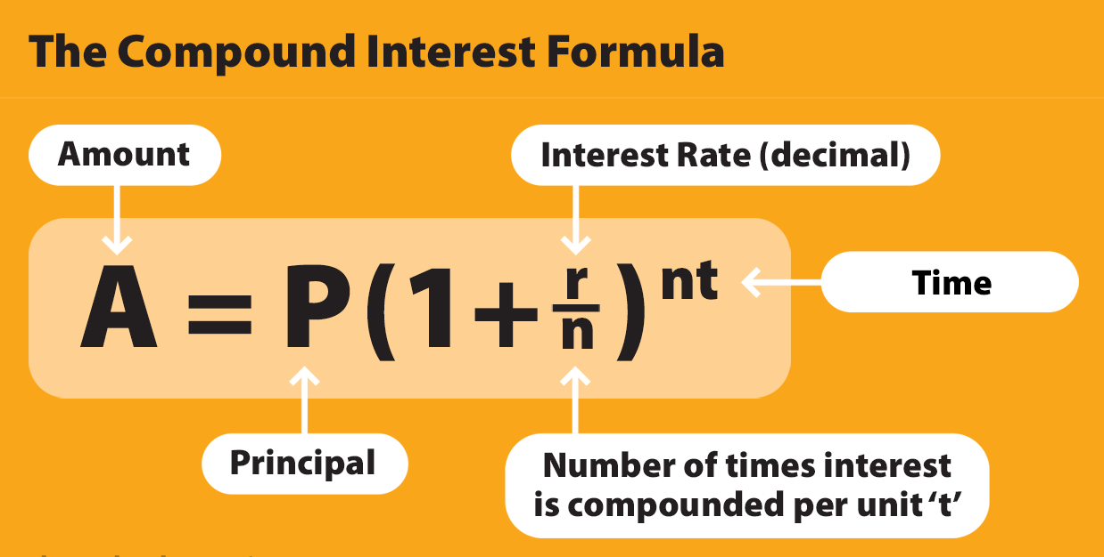
403B
“Compound interest is the most powerful force in the universe.”
Example: An employee has a salary of $45,000 and POA contributes $4,500 to that employee’s 403B. Compounded annually at 6%, 8%, and 10% (historical stock market returns are 12% on average), how much is that worth in 30 years? How much is the total contribution worth in 30 years (Employee + POA)?
A = 4500 (1 + 0.06)³⁰
A = $25,845
A = 4500 (1 + 0.08)³⁰
A = $45,281
A = 4500 (1 + 0.1)³⁰
A = $78,522
6% average return
8% average return
10% average return

Slide 21
2019 Total Compensation Survey Results
Perception of POA’s Annual Leave

Slide 22
Annual Leave
55% don’t believe it’s competitive
About 50% are satisfied and 50% dissatisfied
33% would look for a new job for better AL
“15 days of AL is not competitive. In addition, POA staff work so hard until they get overwhelmed. If POA offers 3-5 days upfront of AL, without the need of accruals, then POA staff may be less dissatisfied with that.”
“There should be more AL days provided to employees with longer tenure at Partners. It should not stop at 3 years.”

Slide 23
2019 Total Compensation Survey Results
Perception of POA’s Sick Leave

Slide 24
Sick Leave
85% of people believe it's important
75% are happy with Sick Leave Policy
Most would not look for another job for better Sick Leave
“I suggest looking into a policy that offers no SL and higher days of AL, that way employees can use AL if they are sick, but if not, they can use it for vacation.”

Slide 25
2019 Total Compensation Survey Results
Perception of POA’s Sick Leave Bank

Slide 26
Sick Leave Bank
75% of people value having a sick leave bank
67% don’t know if a sick leave bank is common at similar organizations
80% are happy that POA has a sick leave bank
“SL bank is not clear in the EM. Employees want to use SL they receive from others without a reasonable leave, at this moment we don’t know if we can use what is donated or not. Very fuzzy policy that could help many of us without hurting the organization.”
“The sick leave bank compensates for tangible benefits. This is very important because if something happens and you need to be out of the office for medical reasons, you are provided with stability.”

Slide 27
2019 Total Compensation Survey Results
Perception of POA’s Sick Leave Donation Policy

Slide 28
Sick Leave Donation
60% value the SL donation policy
66% don’t know if its common at similar orgs
75% are satisfied with the SL donation policy
“The sick leave donation policy is wonderful; however it shouldn’t be considered a substitute for other types of leave policies (i.e. employees shouldn’t have to depend on the goodwill of their colleagues in order to take a reasonable period of paid parental leave).”
“I think this is a very human policy that is good for individuals who benefit and for the group culture. It encourages, or at least gives people the option, to help out their colleagues in a time of need. I think this is a very important benefit, even if it is not used very often.”

Slide 29
2019 Total Compensation Survey Results
Perception of POA’s Parental Leave

Slide 30
Parental Leave
55% value Parental Leave; 25% N/A
20% would consider looking for a new job for better Parental Leave
“Yes for paternity leave, not enough for maternity leave.”
“I think it’s important to note that POA is indeed exceptional when compared with other US employers in that it provides any parental leave at all, but I believe strongly that employers in general should be providing more parental leave, including POA. So I rank POA highly on this score when compared with their peers, but I also don’t think it would be inappropriate to offer 2-4 months of parental leave.”

Slide 31
2019 Total Compensation Survey Results
Perception of POA’s Compassionate Leave

Slide 32
Compassionate Leave
85% value Compassionate Leave
67% don’t know if it’s competitive
48% happy and 33% neutral
“Would be great to provide more time for this leave considering travel days involved in attending a funeral and coming back to the office. 5 days could be more sufficient.”
“Perhaps there should be tiered system. Three days off for the death of a spouse or child seems too little.”

Slide 33
2019 Total Compensation Survey Results
Perception of POA’s Paid Holidays

Slide 34
Paid Holidays
“I appreciate this benefit. However, it would be more effective if time off including holidays and weekends were respected by some supervisors. Sometimes the pressure is too much that we feel obligated to work over the clock until it surpasses our limits, causing so much mental stress.”
“Whenever a paid holiday is approaching and/or when we return from a holiday, would be great to consider how these holidays impact workload and deadlines. For example, holding meetings the day after returning from a holiday isn’t ideal. Also, setting deadlines and program activities in the days before or after are also not ideal. Often times, I find myself working on holidays to account for these demands.”
“In addition to the planned paid holidays, POA often gives a few additional days each year, such as the day after Christmas, especially when it helps the holiday bridge to a weekend…such closures be announced with a bit more notice than is currently typical. Several times it has happened that I have scheduled meeting on days that are then announced as holidays. I usually end up taking the meetings anyway. If the closure were announced a little more in advance (say one week at least), then that would help me avoid that situation or at least have more time to reschedule meetings.”
95% value paid holidays
48% think its competitive and 30% don’t know
77% happy with paid holidays

Slide 35
2019 Total Compensation Survey Results
Perception of POA’s Flex Spending Account

Slide 36
FSA
40% values the FSA
60% don’t know if it’s competitive
Insert FSA5
“I wish the FSA were more open to covering costs such as emergency birth control and allergy medication. This may be outside the scope of the FSA benefit and more of an issue related to FSA in general.”

Slide 37
2019 Total Compensation Survey Results
Perception of POA’s Smart Benefits

Slide 38
Smart Benefits
70% value smart benefits
52% satisfied with current smart benefits
“I believe POA could pay a % of transportation to staff (eg. 30% or 20%).”
“Can this extend to bicycle repair costs?”
“It would be great for Partners to cover more of the SmartTrip benefits especially for those who have longer commutes – it can get expensive.”

Slide 39
2019 Total Compensation Survey Results
Perception of POA’s Flex Work Arrangement

Slide 40
FWA
90% value the Flex Work Arrangement Policy
37% don’t know if it’s common at similar orgs
44% believe its common at similar orgs
“Wish turnaround time to process requests were faster and that the FWA arrangement went beyond a couple of months before revisiting for adjustments.”
“I’m glad that we have this option!”
“I am very happy this was added and it would benefit everyone if it stays.”

Slide 41
2019 Total Compensation Survey Results
Perception of POA’s Comp Time

Slide 42
Comp Time
95% value comp time
52% unhappy with comp time policy
22% would look for a new job with better comp time
Most comments and suggestions out of any prompt
“Current policy doesn’t encourage working on a proposal that requires continuous late nights or work on weekends. Also, doesn’t take into account extra hours of work needed to catch up on regular work once proposal is submitted.”
“I think this policy has to be reviewed and elaborated/clarified further. For example, what if staff have to work over a holiday? Or travel is extensive (I.e. 2 weeks or more)? Do they still receive 1 comp day? In these cases, they should receive more.”

Slide 43
2019 Total Compensation Survey Results
Perception of POA’s Professional Development

Slide 44
Professional Development
93% think this is important
52% would go to another organization for better PD opportunities
56% would go to another organization if there were financial support for PD opportunities
“I don’t think this benefit or process to request it is clearly articulated at an office-wide level”
“I have not received much professional development since working at Partners nor have I been encouraged by leadership to pursue them, much of it because of lack of funding. I would like it if Partners can look into this further.”

Slide 45
2019 Total Compensation Survey Results
Perception of POA’s 30-Minute Paid Lunch

Slide 46
Paid Lunch
74% value 30-minutes of Paid Lunch
60% don’t know if its competitive
“I wish that if we come in at 9am and only take 30 min for lunch, we can leave at 5pm instead of still staying until 5:30pm.”
“Felt like this was not clarified enough in manual!”

Slide 47
2019 Total Compensation Survey Results
Perception of POA’s Total Compensation Package

Slide 48
Total Compensation Package
97% feel it’s important, and 66% think it’s the most important reason of why they work at POA
33% believe the total compensation package is competitive; 19% believe it is not competitive
“Some benefit could definitely benefit more staff without hurting the org. AL for example, and also the use of SL bank donation right away”
“Parental leave, flex work, and professional development don’t factor in to my job”.

Slide 49
Total Compensation Package
48% satisfied with their total compensation package
30% dissatisfied with their total compensation package
52% would seek a new job for a better total compensation package
“Some benefits could definitely be more beneficial to staff without hurting the org.”

